Slide 1
Early Childhood Integrated Data Systems (ECIDS)
Florida Children & Youth Cabinet Meeting
April 14, 2017
Jeff Sellers, SLDS State Support Team
Notes:
Speaker: Missy

Slide 2
Overview of ECIDS
Notes:
Speaker:

Slide 3
What is an ECIDS?
Collects, integrates, maintains, stores, and reports information from early childhood programs
Crosses multiple agencies within a state that serve children and families from birth to age 8
Includes data on the individual child, the child’s family, the classroom, the program/providers, and other services that provide comprehensive care and education for young children
(What is an ECIDS, NCES 2014)
Notes:
Speaker:

Slide 4
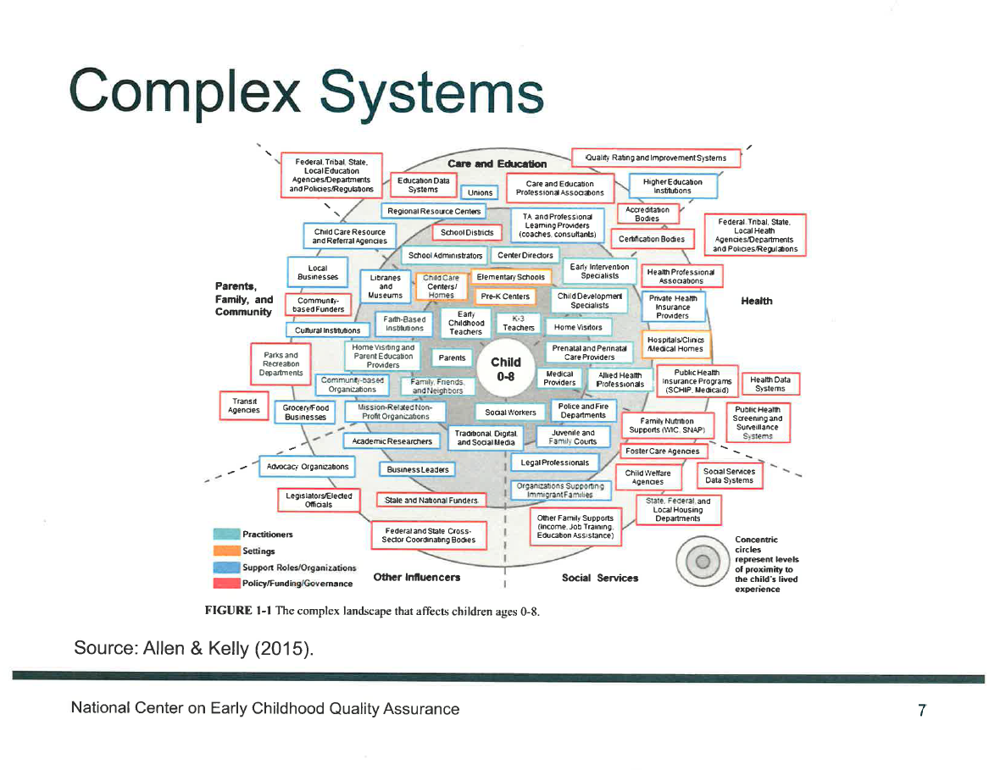

Slide 5
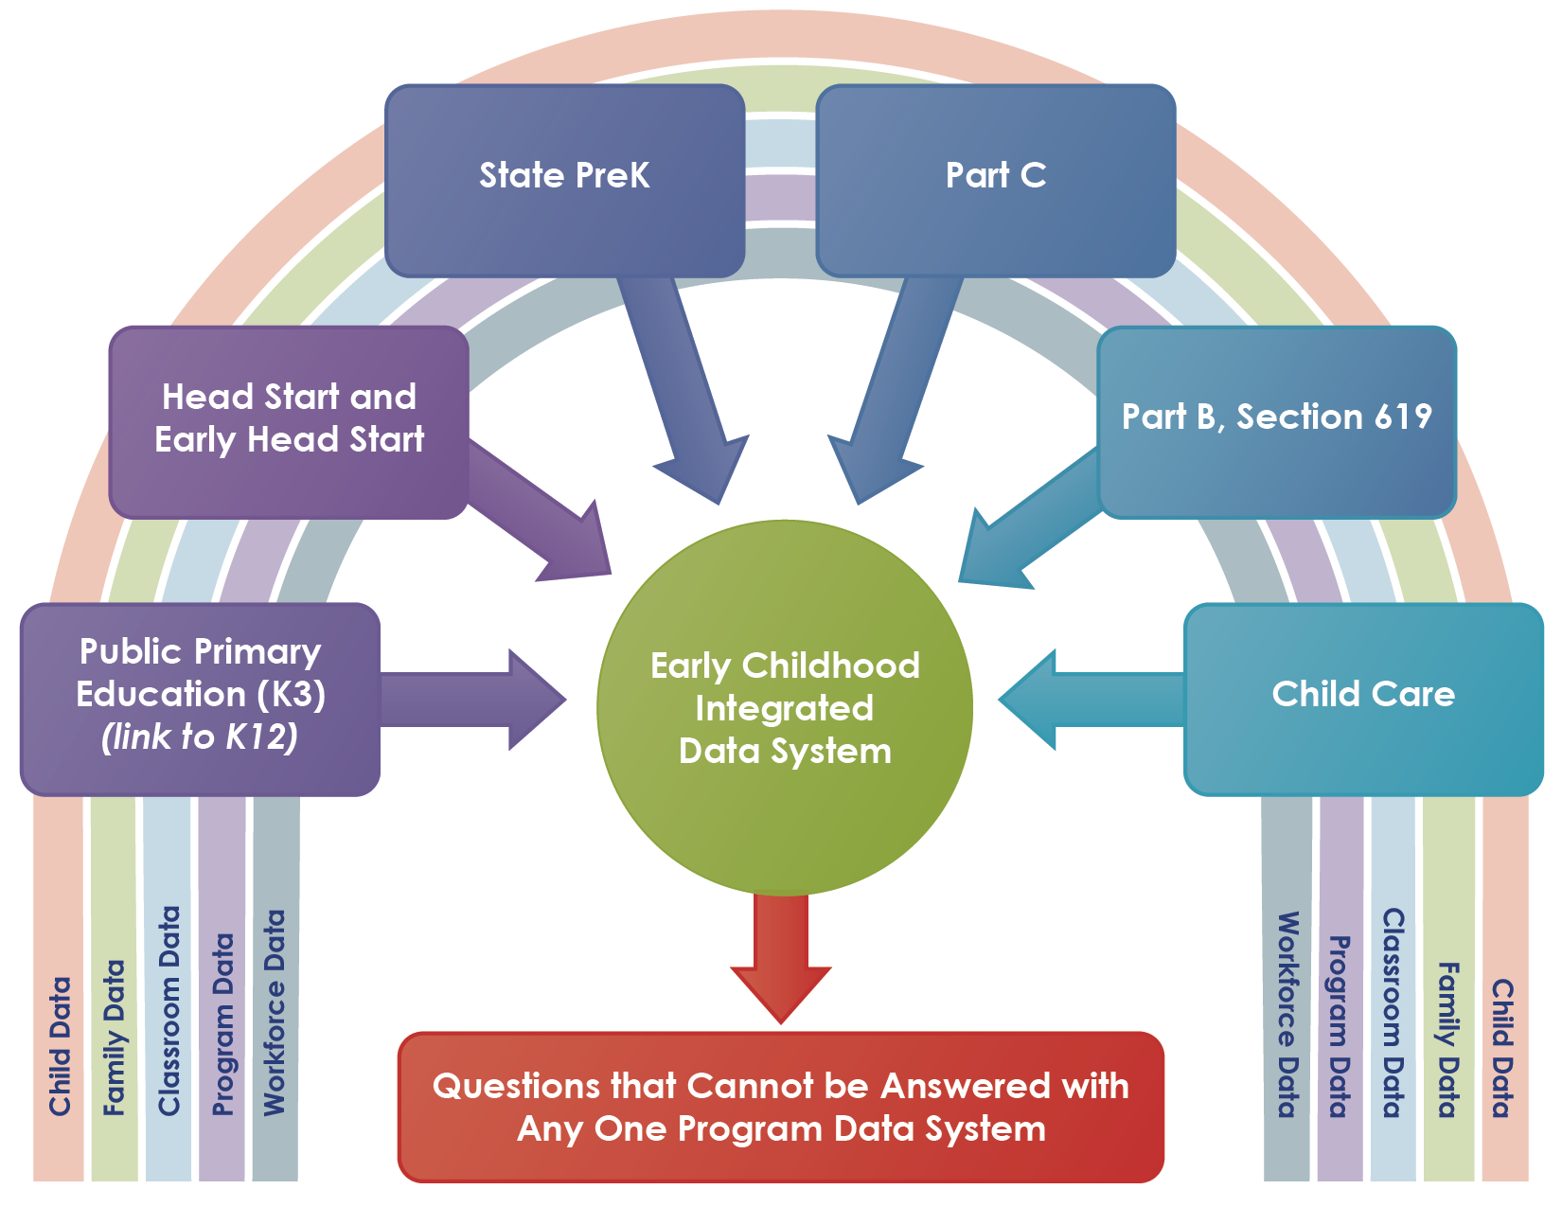
What is an ECIDS?
Notes:
Speaker:

Slide 6
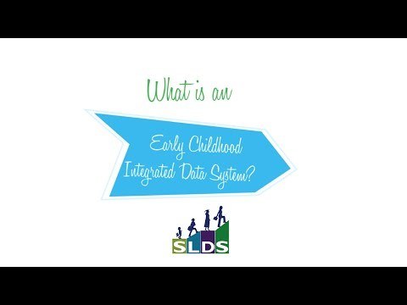
What is an ECIDS?

Slide 7
Example Results of an ECIDS
Answer critical program and policy questions across agencies that provide services to children and families within a state
For example:
  What are the education and economic returns on early childhood investments across state programs?
  Are we preparing all of our children for kindergarten, as a whole and by subgroups?
  What characteristics of programs are associated with positive outcomes for children?
Distinct count of children
Allocation of resources across agencies
NOT: Replacing program data systems used for
operational or key instructional decisions
Notes:
Speaker:

Slide 8
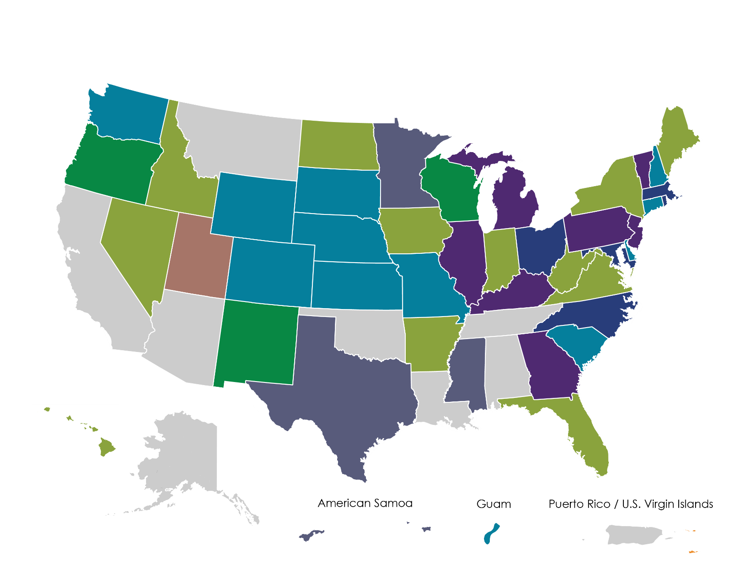
Funding ECIDS
RTT-ELC States ECIDS – Round 1
RTT-ELC States ECIDS – Round 2
RTT-ELC States ECIDS – Round 3
States Using SLDS for ECIDS –
EC Specific (U.S. Virgin Islands)
States Using SLDS Grant to Include EC in P-20
States Using Internal Resources for ECIDS
ECCS Grant Toward ECIDS (Utah)
FY15 SLDS Grantees with Early Learning Priority Area
States Not Working Toward an ECIDS

Slide 9
ED Funding for Early Learning Data Systems: SLDS and RTT-ELC
SLDS (ARRA, FY12, FY15)
Many states began incorporating “P” into SLDSs early on
According to SLDS program data, 21 states include a focus on building an ECIDS connected to K12/P-20 systems via SLDS
In FY12, one territory was funded specifically to focus on building an ECIDS (Virgin Islands)
In FY15, three states and one territory were funded to focus on Early Learning (American Samoa, Mississippi, Minnesota, Texas)
RTT-ELC
States could choose to build or enhance a coordinated early childhood data system (Selection Criteria E2)
16 out of 20 RTT-ELC (rounds 1-3) grantees have data
systems included in their scopes of work
Notes:
Speaker:

Slide 10
The Evolution
Phase 1: 2011-2013
Planning- States began to plan
0 states with operational systems
Approximately 20 states planning
Phase 2 2013-2015
Implementation
0 states with operational systems
Approximately 31 states planning
Over 20 with functioning, implemented data governance
Phase 3: 2016- Present
Operational
3 states with operational systems
Approximately 37 states planning
Over 25 with functioning, implemented data governance
Phase 4: TBD
Evaluation and Data Use
Mores states with operational systems and examples of data use to inform decisions

Slide 11
How are states using ECIDS Data?
Identifying and documenting the distinct count of children being served
Support training/professional development and teacher qualifications/credentials
Understand child outcomes
Inform the quality rating/outcomes
Support transitions (between C/619, PreK-K, etc.)
Prepare children and families to be ready for school
Using data to support enrollment and recruitment across agencies

Slide 12
Utah’s Early Childhood Integrated Data System

Slide 13

Division of Family Health and Preparedness
Bureau of Child Development
TITLE V Maternal/child/infant health
Early Intervention IDEA – Part C
Office of
Home
Visiting
Child
Care
Licensing
Early Childhood
Utah

Slide 14


Governor’s State Advisory Council on Early Care and Education
Section 642 B(b)(1)(A)(i) of the Head Start Act requires the Governor to designate or establish a council to serve as the State Advisory Council on Early Childhood Education and Care for children from birth to school entry.
Early Childhood Comprehensive Systems Grant
A program of the US Department of Health & Human Services, Maternal and Child Health Bureau.
Early Childhood Utah
In September 2011, Governor Herbert designated the existing Early Childhood Comprehensive Systems State Team to also function as the State Advisory Council on Early Care and Education, resulting in the creation of Early Childhood Utah.
Notes:
Early Childhood Utah is housed within Utah’s Department of Health; the original “start-up” funding for Utah’s Early Childhood Integrated Data System was generated from an Early Childhood Comprehensive Systems Grant. EC database integration discussion began in the summer 2011.

Slide 15

The goal of Early Childhood Utah is to:
Support Utah parents in their efforts to ensure that their children enter school healthy and ready to learn.

Slide 16
Early Childhood Integrated Data Systems
Part B -Special Ed Pre-K
Part C Early Intervention
The data integration system will facilitate the use of data to address five broad policy questions:
Are children birth to age 5 on track to succeed when they enter school?
Which children and families are and are not being served by which programs and services?
What characteristics of programs are associated with positive outcomes for which children?
What are the education and economic returns on early childhood investments?
How is data being used now and how will data be used in the future to inform policy and resource decisions?
Head Start
Child Care
ECIDS -Questions that cannot be answered with any one system
Public Pre-K-Title One
Home Visiting

Slide 17
Utah ECIDS High Level Overview
EARLY CHILDHOOD UTAH
Utah Data Alliance
P-20W
Vital Records (birth/death), Hearing Detection, Immunizations
Post-secondary
All Payer Claims Database: All Insurances
ECIDS
Non PII
UID
K-12
Workforce
Home Visiting & Early Intervention (Idea Part C)
DOH-ECIDS
MPI/ PII
P-20W
Data Warehouse
Non PII
Child Care,
ASQ, Help Me Grow, United Way
Community Head Start Programs
WIC,TANF,
SNAP, Children w/ Special Health Care Needs
Early-Childhood Researchers
Education Researchers
Notes:
Vital Records (birth and death), All Payer Claims Database (all 3rd party insurance, including Medicaid, CHIP, BXBS, etc), Early Hearing Detection and Intervention, Maternal Infant Early Childhood Home Visiting, Early Intervention IDEA Part C. These databases are used to assist the data system with identity verification and matching the child to the early childhood services received. De-identified data is sent to ECIDS; ECIDS can then be queried to produce phase I standard reports which include a distinct count of children that are receiving one or more services and the order or sequence of services that have been received.

Slide 18
Utah’s ECIDS- how does it work?
ECIDS uses Axon technology (MDSC) within the ECIDS MPI data system for data collection, identity correlation and routing.
The ECIDS MPI system processes personally identifiable information (PII) to uniquely identify children across multiple data sources.
Non-PII data is collected and sent directly (encrypted) to the ECIDS database from the ECIDS/MPI system.
ECIDS Phase I reports: distinct counts, program crossover, sequence of services.

Slide 19

State Spotlight:
Minnesota’s Early Childhood Integrated Data System-http://eclds.mn.gov/

Slide 20
Data Collection & System
Dept of Human Services
Child Care Assistance Program
TANF (“MFIP”)
Dept of Health
Birth Records
Dept of Education
K12 Enrollment & Assessment
Early Childhood Special Education
ACCESS (English Learners)
EE Student
Kindergarten Entry Profile
Teacher licensing and organization data
TQRIS (“Develop”)
SNAP
Web Site
How many children are served?
In what programs are children participating?
In what type of quality program do children participate?
What are child outcomes over time?
Linking and De-identifi-cation
Notes:
[Anita] This diagram shows the departments that currently contribute data to the ECIDS, the types of program data contributed, the point at which data are linked and then de-identified before being loaded into the warehouse. At the public interface, the web site, these are the broad policy questions that our web site analytics are intended to answer. These questions offer a sense of what these charts and graphs will look like.

Slide 21
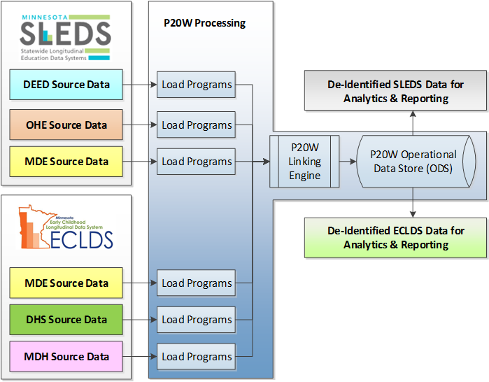

System & Shared Architecture
Notes:
Data warehouse was developed using SQL Server (SSIS).
Data reporting web service was developed using WebFocus report server and HTML application for front end reports.
Mobile Analytics? Mobile first.

Slide 22
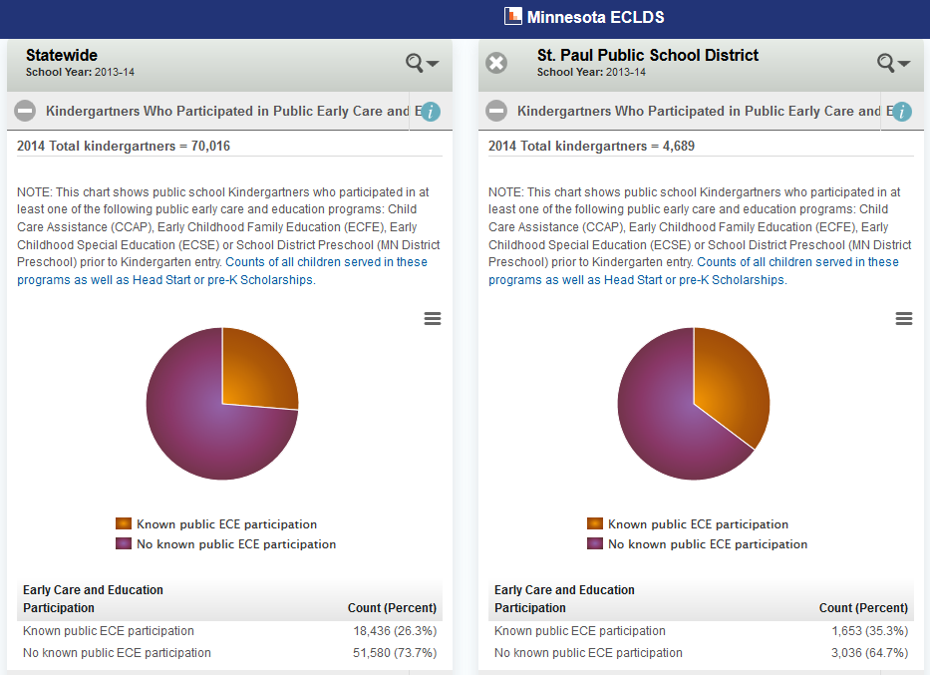
Early Results: Program Participation (test data only)
Test Data Only
Notes:
This shows an example of the high-level program participation data that our state has been seeking. This test data shows a comparison of statewide and St. Paul Public Schools early care and education program participation prior to kindergarten entry for a cohort of kindergarten students.

Slide 23
Hot Off the Press!
New Early Learning IPB Report on Integrated Data
Check it out!
  HSS https://www.acf.hhs.gov/sites/default/files/ecd/intergration_of_early_childhood_data_final.pdfLink
  Education http://www2.ed.gov/about/inits/ed/earlylearning/index.html?src=rn&utm_content=&utm_medium=email&utm_name=&utm_source=govdelivery&utm_term=
Recently released!
  Highlights ECIDS progress in 8 states
  Discusses key considerations for early childhood data integration
  Links to related federal resources and technical assistance
Notes:
Early Learning Interagency Policy Board (IPB) Report

Slide 24
State Example Resources
State Spotlight: North Carolina’s Early Childhood Integrated Data System (ECIDS) https://slds.grads360.org/#communities/pdc/documents/10161
State Spotlight: The Utah Early Childhood Statewide Data Integration Project https://slds.grads360.org/#communities/pdc/documents/10001
State Spotlight: Minnesota’s Early Childhood Integrated Data System https://slds.grads360.org/#communities/pdc/documents/9763
State Spotlight: Delaware’s Early Learning Insight Dashboard https://slds.grads360.org/#communities/pdc/documents/9356
Notes:
Speaker:

Slide 25
Early Childhood Interagency Data Governance

Slide 26
The Roles of Within Sector & Cross Sector Governance
EC Data Governance
Statewide perspective
Determine integration and data element authority
Driven by state policy
DOH
Data Governance
SEA Data Governance
HHS
Data Governance
DOL
Data Governance
Other EC Data
Program centric
Determine data elements, definitions, collections
Driven by program essential questions

Slide 27
Differences between Data Gov. &
Stakeholder Engagement
Membership
Data governance: Representatives (leadership, program, and IT staff) from each agency/program contributing data to an early childhood integrated data system (ECIDS)
Stakeholders
Data Governance
Stakeholder engagement: Users of the ECIDS data and those directly or indirectly affected by its use (including data governance members)

Slide 28




EC Centralized ECIDS
Presentation Layer:
Reports, Data Marts, Datasets
Metadata
EC Data System
Student Identities
INTEGRATION
MATCHING
Child
Care
Head Start
State
PreK
Early Intervention – Part B
Early Intervention – Part C
Home
Visiting
Other
Data
K12
Data

Slide 29
ECIDS Toolkit Overview
Notes:
Speaker:

Slide 30
The ECIDS Toolkit is now available online at
https://slds.grads360.org/#program/ecids-toolkit
Notes:
Speaker:

Slide 31
ECIDS Guide Outline
Purpose and Vision for the ECIDS
Planning and Management
Stakeholder Engagement
Data Governance
System Design
Data Use
Sustainability

Slide 32
Purpose of the ECIDS Toolkit
Provide a method for states to assess progress in developing
an ECIDS
Enhance the capacity of states working to integrate data across early childhood to understand the key pieces of an ECIDS and how it connects with the states’ other integrated data system efforts so they can lead or actively participate
  Provide resources and state examples to help build better systems of services and programs that will improve outcomes for young children and families
  Offer practical suggestions for each step in the overall
  process of integrating early childhood data and
  connecting that data to an SLDS
Notes:
Speaker:

Slide 33
ECIDS Toolkit: Key Points
The ECIDS Toolkit is not meant to be used in one way. It is intended to help states with their planning and development processes.
The ECIDS Toolkit was designed to be flexible so that states can use it to their best advantage. Content can be accessed in different ways (downloadable in sections or in its entirety) and at different levels (drilldown to elements of quality).
The ECIDS Toolkit provides easy access to additional resources.
Notes:
Speaker:

Slide 34
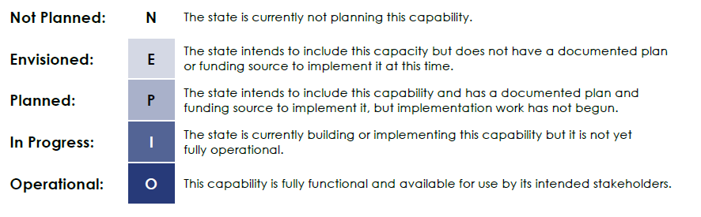
ECIDS Scale for Self-Assessment
  Based on the feedback from the group, the final scale was
  as follows:*
*The scale can be used at either the indicator or element level based on the state’s goal.

Slide 35
Discussion
What value would integrating EC data have for Florida?
Who would be interested in integrated EC data (stakeholders)?
Is there any current state statutes encouraging the integration of EC data?

Slide 36
Discussion
What barriers do they see in integrating EC data in FL? (e.g. tech challenges/Policy challenges) How could the barriers be overcome?
What are some next steps (6 months)?
  Further discussion about data governance, tech models, data use examples

Slide 37
Resources
ECIDS Toolkit
https://slds.grads360.org/#program/ecids-toolkit
What is an ECIDS? https://slds.grads360.org/#communities/pdc/documents/4441
Planning for Early Childhood Data Use https://slds.grads360.org/#communities/pdc/documents/2635
Strategies for Engaging Early Learning Stakeholders https://slds.grads360.org/#communities/pdc/documents/5908
Notes:
Speaker:

Slide 38
Resources
Answering Key Questions with an Early Childhood Data System https://slds.grads360.org/#communities/pdc/documents/4798
Identifying SLDS Users and Their Information Needs https://slds.grads360.org/#communities/pdc/documents/2753
Communicating Early Childhood Integrated Data System (ECIDS) Design: Developing Presentation and Conceptual Diagrams
https://slds.grads360.org/#communities/pdc/documents/8620
Notes:
Speaker:

